Slide 1
Quote of the month!
It’s not a unit visit…
… until it’s entered in UVTS!

Slide 2
COMMISSIONER Training Updates

Slide 3
BASIC TRAINING
16 June CBT – Huge Success!
10 Participants
7 Staff

Slide 4
BASIC TRAINING
District Commissioners need to give leadership! (Dan Urban to Coordinate)
• December 15, 2012 – Area 2 & 4
• February 23, 2013 – Area 1
• April 20, 2013 – Area 3
• June 15, 2013 – Area 6

Slide 5
NEW! BASIC TRAINING
(Revised/Shortened) Commissioner Basic Training
First presentation: 18 August @ Barbecue
New Unit Commissioner Basic Training
18 August @ Barbecue
District Commissioner & Assistant District Commissioner Basic Training
20 October @ DLC

Slide 6
DATE CONFLICT
Area 3 – Roundup Festival
• August 18, 2012 – Camp Guyasuta 8 AM to Noon
Fall Kick-off & Barbecue (with CBT)
• August 18, 2012 – Camp Twin Echo Noon to 8 PM

Slide 7
20 October 2012
Don’t Miss It!

Slide 8
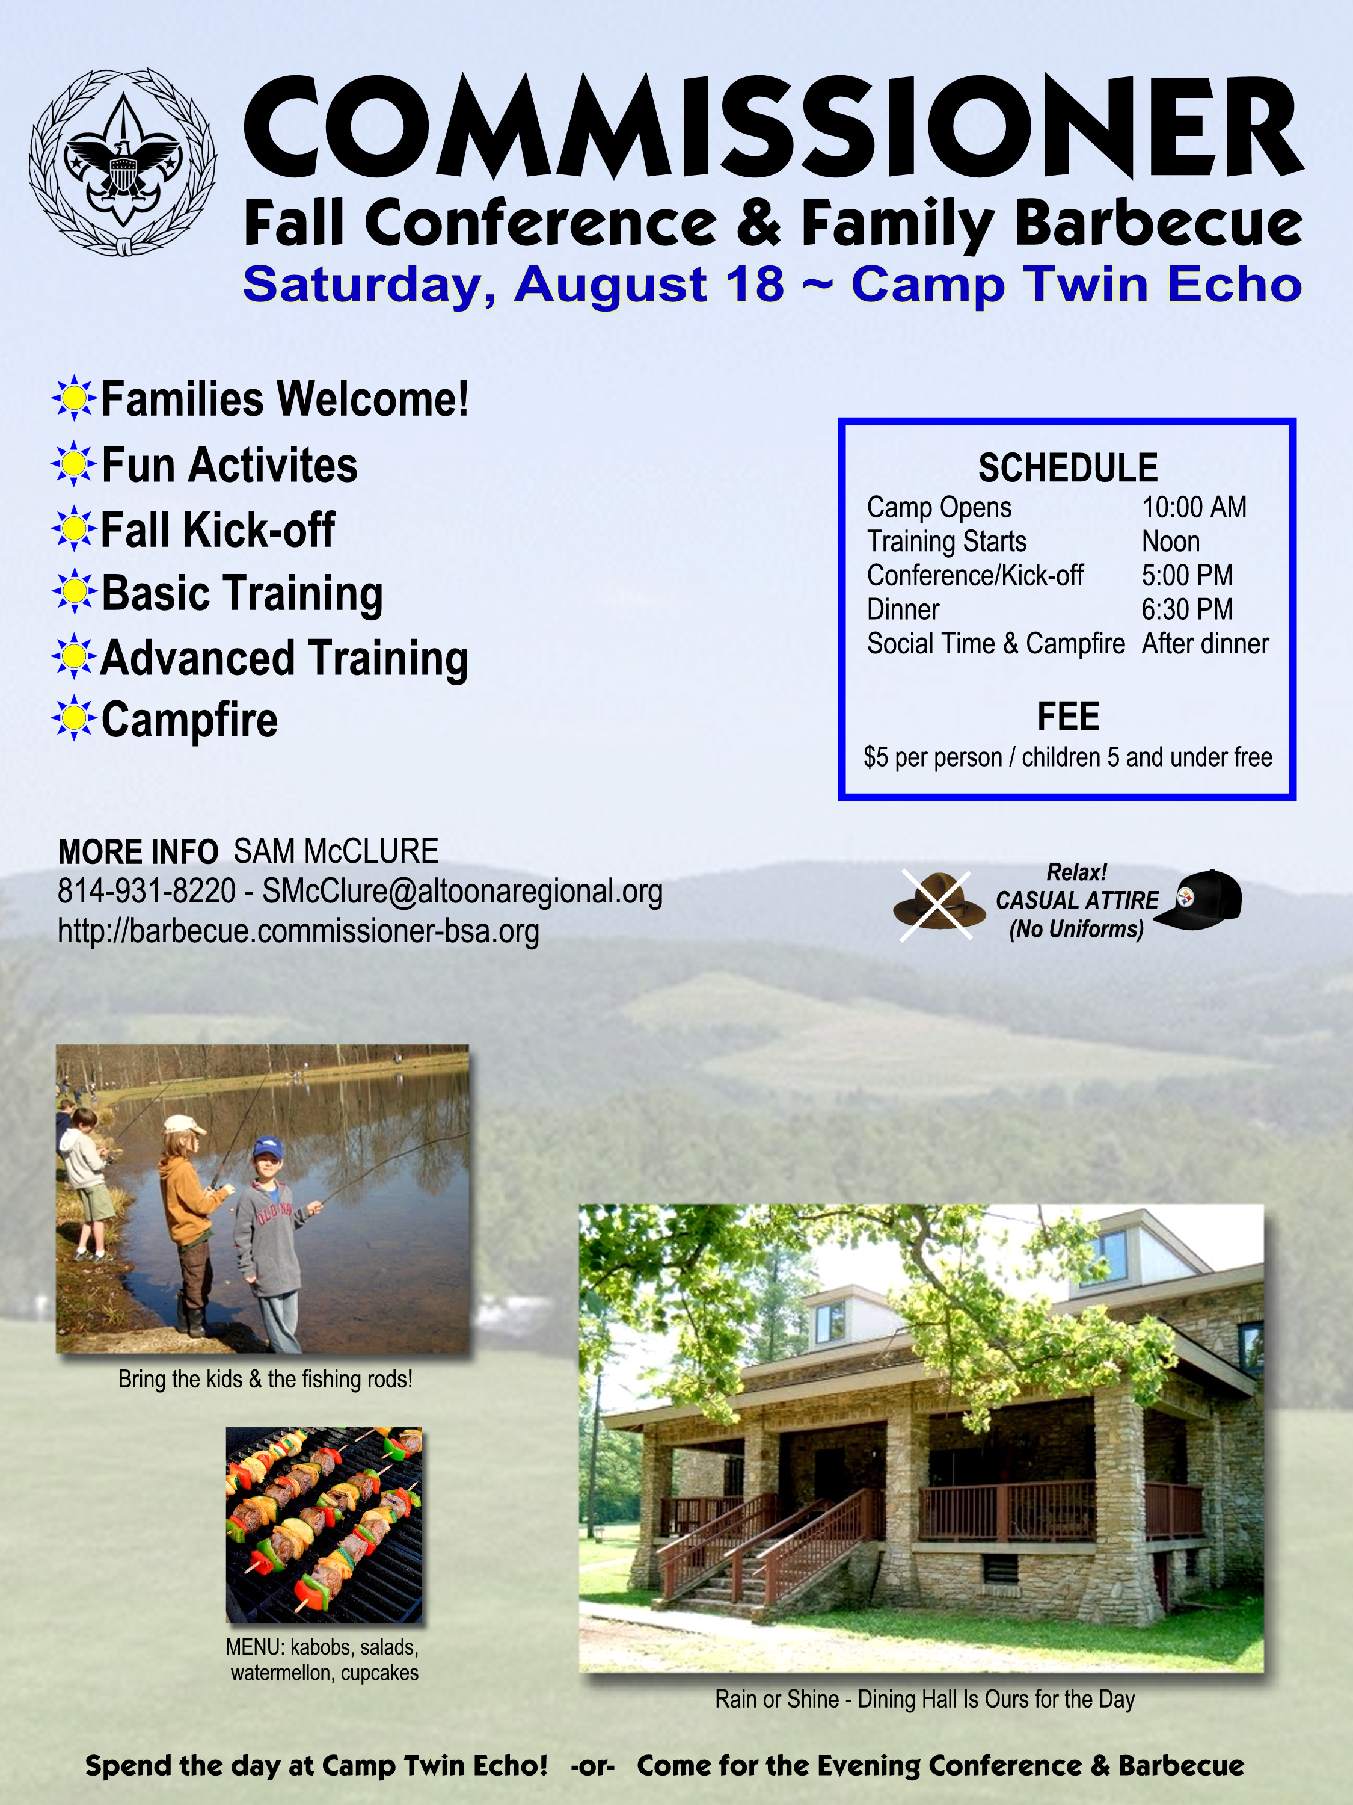
FALL KICK-OFF & BARBECUE
FUN!
August 18 @ Camp Twin Echo

Slide 9
Distinguished Commissioner Service Award
Nominations due 15 July E-mail to rbausher@hotmail.com
Presentation 18 August @ Barbecue
Recognize your BEST Commissioners!

Slide 10
